Slide 1
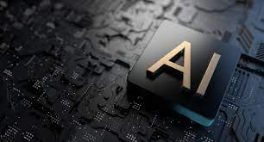

Artificial Intelligence and IoT
Journal Writing

Slide 2
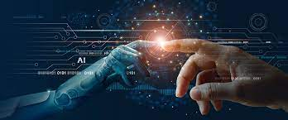
Day 1: The Introduction and History
What is Artificial Intelligence?
One definition of Artificial Intelligence (AI) is “a branch of computer science dealing with the simulation of intelligent behaviour in computers.”
In other words, AI is the ability of a computer or machine to do things that ordinarily require human intelligence, such as understanding natural language and recognizing objects. History of Artificial Intelligence.
The history of AI is often divided into three periods:
The Pre-History of AI (up to 1956): In this period, AI was mostly theoretical, and researchers were focused on creating algorithms that could perform specific tasks, such as playing checkers or solving algebraic equations.
The Early History of AI (1956-1974): This period was marked by two key events: the publication of a paper by 1956 Dartmouth AI conference, which is often considered the birth of AI as a field, and the creation of the first AI program, ELIZA, in 1966. ELIZA was a simple program that could mimic human conversation, and it showed that computers could be used to create lifelike interactions.
The Modern History of AI (1974-present): This period is characterized by rapid progress in the field of AI, due to both theoretical and practical advances. In 1997, a computer program called Deep Blue beat world chess champion Garry Kasparov, marking a major milestone in AI history. More recently, AI has been used for tasks like facial recognition, self-driving cars, and medical diagnosis.
18-11-2022
Reference : https://www.artificialintelligence-news.com/

Slide 3
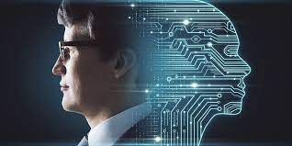
Day 2 : The latest Milestones in Ai
Deep learning has made significant progress, with algorithms now able to outperform humans on some tasks such as image recognition.
Natural language processing has made strides, with AI now able to understand and generate human-like speech.
Robotics has also advanced, with robots now able to autonomously navigate and interact with their surroundings.
AI is also being used more and more for predictive analytics, helping businesses make better decisions about the future.
The development of deep learning algorithms that can learn to recognize objects, faces, and scenes with incredible accuracy.
The creation of artificial intelligence systems that can beat humans at complex games such as Go, chess, and poker.
The creation of personal assistants such as Siri, Alexa, and Google Assistant, that can understand and respond to natural language queries.
The development of chatbots that can carry on conversations with humans.
The creation of digital assistants that can proactively make suggestions and take actions on behalf of users.
The development of robots that can work alongside humans in factories, hospitals, and homes.
The creation of algorithms that can automatically generate new images, videos, and text.
The development of systems that can automatically read and understand documents.
The creation of artificial intelligence systems that can identify and diagnose diseases.
19-11-2022
Reference : https://www.sciencedaily.com/news/computers_math/artificial_intelligence/

Slide 4
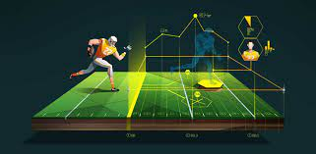
Day 3 : AI in Sports Arena
In May 2017, Google's AlphaGo AI beat world champion Go player Ke Jie in a three-game match. This was a major milestone, as Go is considered to be a very complex game that is difficult for computers to play well.
Also in May 2017, Microsoft announced that its AI chatbot Zo had beaten human chatbots in a Turing test. This test is designed to see if a computer can fool humans into thinking it is also human.
In June 2017, Google's DeepMind AI company announced that its AI software had mastered the game of 3D chess. This is significant because it is the first time an AI has been able to beat a top human player at a game that requires strategic thinking.
In July 2017, Facebook's AI research lab announced that its AI software had created its own language that was different from English. This is a milestone as it shows that AI is capable of creating its own language.
In September 2017, Google's AI software AlphaGo Zero beat the previous version of AlphaGo, which had beaten Ke Jie, in a 100-game match. This showed that AI can learn and improve at a much faster rate than humans.
In October 2017, Google's AI software Duplex beat humans in a reading and comprehension test. This is significant as it showed that AI can understand human language better than humans can.
In November 2017, Google's AI software AlphaGo Zero beat the world's best Go player, Lee Sedol, in a four-game match. This was a major milestone as it showed that AI can now beat the best humans at Go, which is considered to be the most complex board game in the world.
In December 2017, Microsoft's AI chatbot Zo beat human chatbots in a second Turing test. This showed that AI is continuing to improve at a rapid pace.
In January 2018, Google's DeepMind AI software AlphaGo Zero beat the world's best Go player, Ke Jie, in a three-game match. This was a major milestone as it showed that AI can now beat the best humans at Go.
In February 2018, Google's DeepMind AI software AlphaGo Zero beat the world's best Go player, Lee Sedol, in a four-game match. This was a major milestone as it showed that AI can now beat the best humans at Go.
20-11-2022
Reference : https://techxplore.com/machine-learning-ai-news/

Slide 5
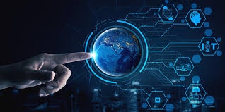
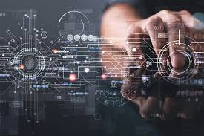
Day 4 : The Entry of IoT
The Internet of Things, or IoT, is a system of interconnected devices and sensors that can collect and share data. The IoT has the potential to revolutionize the way we live, work, and play by making everyday objects and devices more connected and intelligent.
The IoT is still in its early stages, but it is already changing the way we live and work. Here are some of the latest milestones in the development of the IoT:
1. More than 26 billion devices are already connected to the Internet of Things, and this number is expected to grow to more than 75 billion by 2025.
2. The IoT is expected to generate $1.7 trillion in economic value by 2025.
3. The IoT is already transforming industries such as manufacturing, healthcare, transportation, and retail.
4. The IoT is also changing the way we live our everyday lives, with connected devices such as smart thermostats, home security systems, and wearable devices becoming more common.
5. The IoT is also becoming more secure, with new standards and protocols being developed to ensure the privacy and security of data collected by IoT devices.
21-11-2022
Reference : https://www.iottechnews.com/

Slide 6
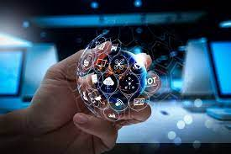
Day 5 : The latest Milestones of IoT
IoT has been around for a while now and it is constantly evolving. Some of the latest milestones in IoT include:
-The release of the world’s first IoT operating system: The Things Operating System, or TTOS, is a Linux-based operating system designed specifically for IoT devices. It is open source and can be used on a variety of hardware platforms.
-The launch of Amazon Web Services IoT: AWS IoT is a cloud platform that lets connected devices easily and securely interact with cloud applications and other devices.
-The launch of Google Cloud IoT: Google Cloud IoT is a complete set of tools to connect, process, store, and analyze data from globally dispersed devices.
-The release of Microsoft Azure IoT Suite: Azure IoT Suite is a set of integrated IoT services that allow you to connect, monitor, and manage your IoT assets at scale.
-The launch of IBM Watson IoT: Watson IoT is a cognitive system that enables a new partnership between people and computers. It can help you transform your business by infusing intelligence into the systems you use every day.
22-11-2022
Reference : https://www.iotworldtoday.com/type/news/

Slide 7
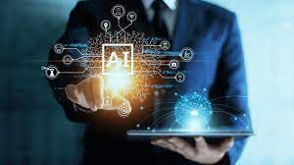
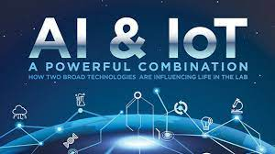
Conclusion
These are just a few of the latest milestones in AI and IoT. As you can see, AI is becoming more and more advanced and is starting to outperform humans in many tasks.
So, what does the future hold for AI?
Some experts predict that AI will eventually surpass human intelligence and become super intelligent.
Others believe that AI will help humans to become smarter and enhance our cognitive abilities.
Regardless of what the future holds, one thing is for sure, AI is changing the world as we know it and the possibilities are endless.

Slide 8
References
https://www.artificialintelligence-news.com/
https://www.sciencedaily.com/news/computers_math/artificial_intelligence/
https://techxplore.com/machine-learning-ai-news/
https://www.independent.co.uk/topic/artificial-intelligence

